Slide 1
Module3_SupportVectorMachine
References:
Ethem Alpaydin, "Introduction to Machine Learning”, MIT Press, Prentice Hall of India

Slide 2
Support Vector Machine
SVM is a supervised learning model
Data in a dataset are associated with a label
Example
Identify the mails in the mailbox as ‘complaint’ or not ‘complaint’
Classification
Linearly separable data
Maximal-margin classifier
Linearly inseparable data
Kernel trick SVM
Regression
Support Vector Regression
SVM can also be Unsupervised
Support Vector Clustering
Define the discriminant in terms of support vectors

Slide 3
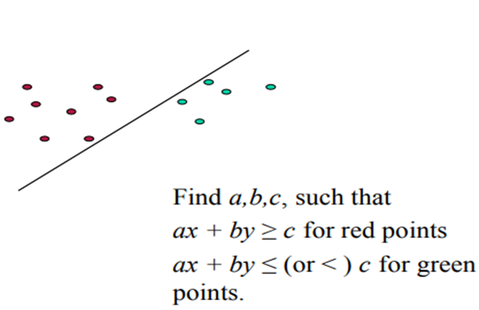
Example
Red Coordinates – Positive Samples

Slide 4
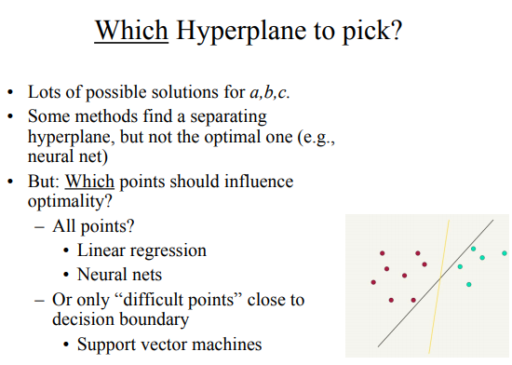
Discriminating Plane
Max Margin Plane

Slide 5
Optimal Separating Hyperplane
In General,
(Cortes and Vapnik, 1995; Vapnik, 1995)

Slide 6
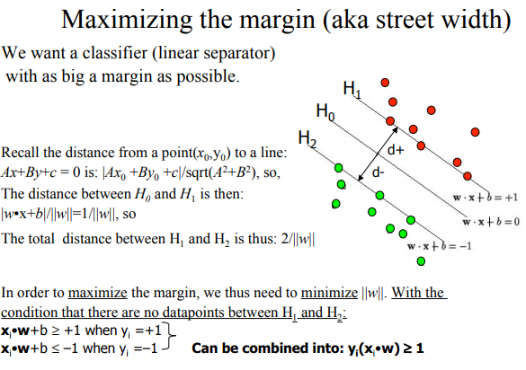
Maximizing the Margin

Slide 7

Margin
Distance from the hyperplane to the instances closest to it on either side is called the margin, which needs to be maximized for best generalization.
Distance of x to the hyperplane is
We require
Aim: To maximize ρ
but there are an infinite number of solutions that we can get by scaling w
For a unique sol’n, fix ρ||w||=1

Slide 8

Lagrangian Method
Consider the optimization problem
maximize f(x, y) subject to g(x, y) = 0.
Lagrange function (or Lagrangian or Lagrangian expression) is defined by
L ( x , y , λ ) = f ( x , y ) − λ ⋅ g ( x , y )
For the general case of an arbitrary number n of choice variables and an arbitrary number M of constraints, the Lagrangian takes the form
(Cortes and Vapnik, 1995; Vapnik, 1995)

Slide 9
Lagrangian Method
Most α^{t} are 0 and only a small number have α^{t} >0; they are the support vectors

Slide 10
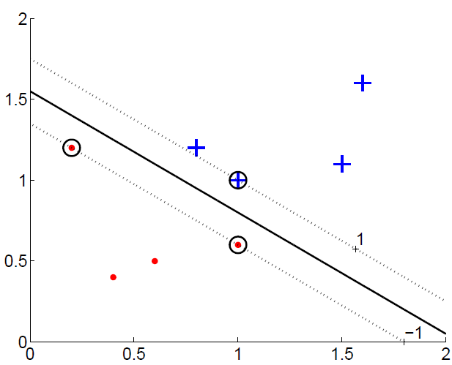
Margin
For a two-class problem where the instances of the classes are shown by plus signs and dots, the thick line is the boundary and the dashed lines define the margins on either side. Circled instances are the support vectors.

Slide 11
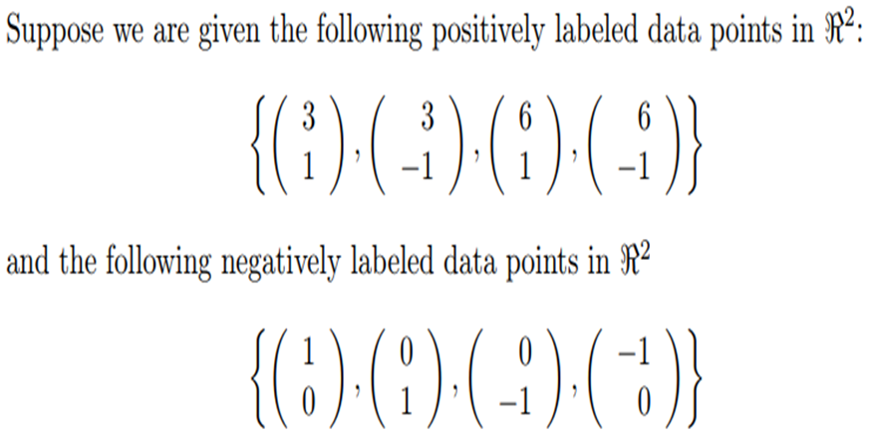
SVM by Example –Linearly separable data

Slide 12
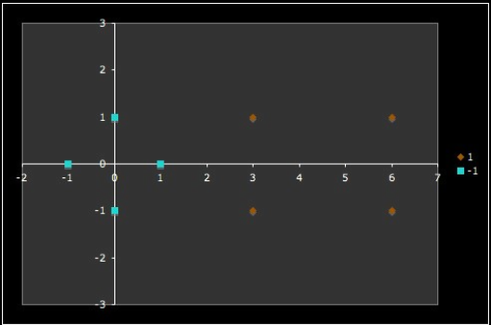

Support
Vectors are

Slide 13
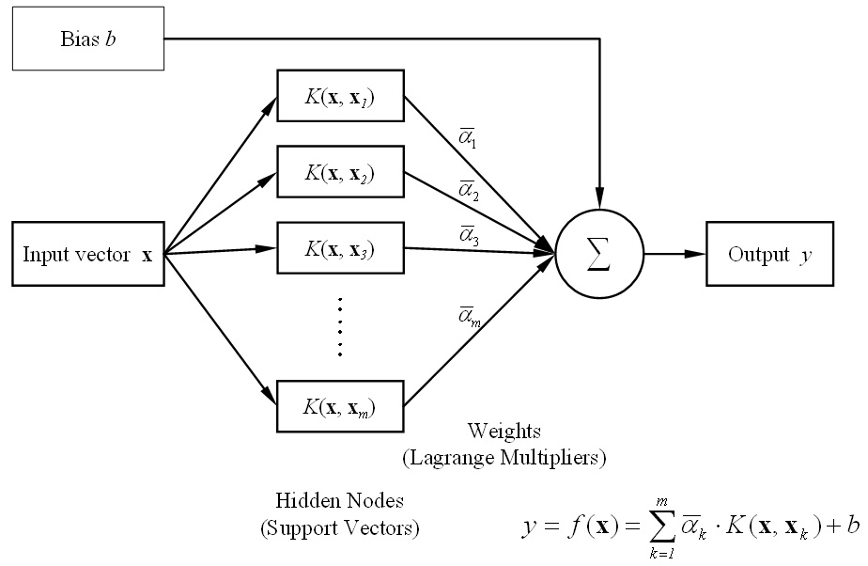
Architecture

Slide 14
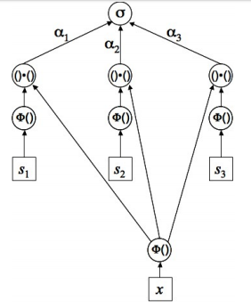

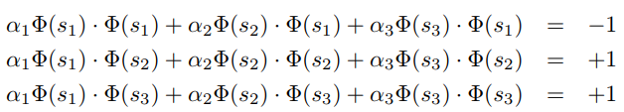
SVM Architecture

Slide 15

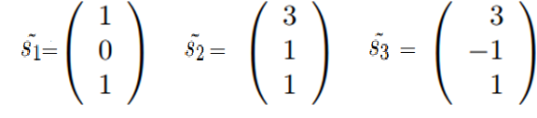

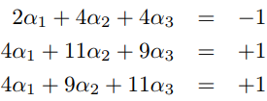
Three support vectors without bias term are represented as follows:
Three support vectors with bias term are represented as follows:

Slide 16
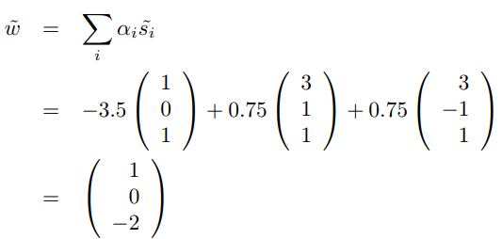

By solving α₁ = −3.5, α₂ = 0.75 and α₃ = 0.75

Slide 17
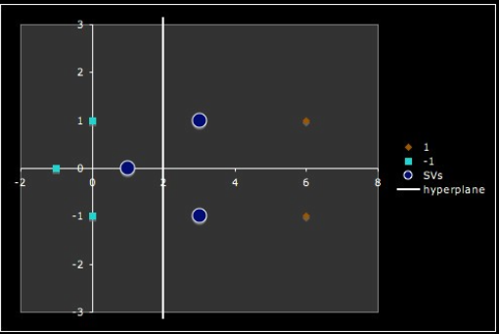
Hyperplane

Slide 18
SVM Example - 2
Construct a linear discriminant with :
Positive samples : (1,1) , (1,-1), (2,1), (2,-1)
Negative samples : (4,0) , (6,0), (5,1), (5,-1)

Slide 19
The Nonseparable Case: Soft Margin Hyperplane
If the data is not linearly separable, then there is no hyperplane to separate them into one of the two classes.
Solution: Identify a hyperplane that incurs least error.
Slack variables, ξ^{t} ≥ 0, are defined which stores the deviation from the margin.
Two types of deviations:
An instance may lie on the wrong side of the hyperplane and be misclassified.
Or, it may be on the right side but may lie in the margin, namely, not sufficiently away from the hyperplane.
Hence
r^{t}(w^{T} x^{t} + w₀) ≥ 1 − ξ^{t}

Slide 20








The Nonseparable Case: Soft Margin Hyperplane
We allow “error” ξ_{i} in classification; it is based on the output of the discriminant function w^{T}x+b
ξ_{i} approximates the number of misclassified samples
Class 2
Class 1

Slide 21
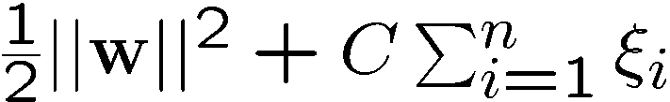
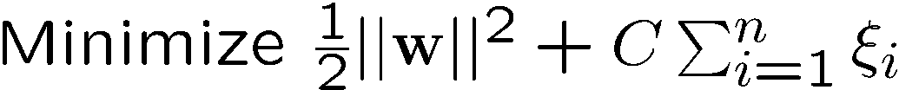
Soft Margin Hyperplane
We need to minimize ∑_{i}ξ_{i}
ξ_{i} are “slack variables” in optimization
Note that ξ_{i}=0 if there is no error for x_{i}
ξ_{i} is an upper bound of the number of errors
The primary problem is to minimize
C : penalty factor, tradeoff parameter between error and margin.
The optimization problem becomes

Slide 22
Extension to Non-linear Decision Boundary
Large-margin classifier has been considered with a linear decision boundary
To generalize it to become nonlinear :
Key idea: transform x_{i} to a higher dimensional space
Input space: the space the point x_{i} are located
Feature space: the space of φ(x_{i}), after transformation

Slide 23
Transforming the Data
φ( )
φ( )
φ( )
φ( )
φ( )
φ(.)
φ( )
φ( )
φ( )
φ( )
φ( )
φ( )
φ( )
φ( )
φ( )
φ( )
φ( )
φ( )
φ( )
Input space
Feature space
Note: feature space is of higher dimension than the input space in practice
Computation in the feature space can be costly because it is high dimensional
The feature space is typically infinite-dimensional!
The kernel trick helps in this context.

Slide 24

Non-linear SVMs: Feature spaces
Example: the original input space can always be mapped to some higher-dimensional feature space where the training set is separable:
Φ: x → φ(x)

Slide 25
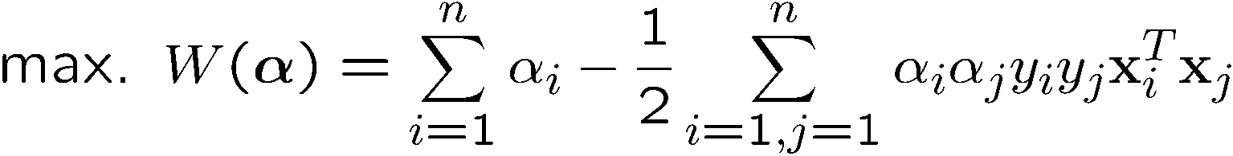
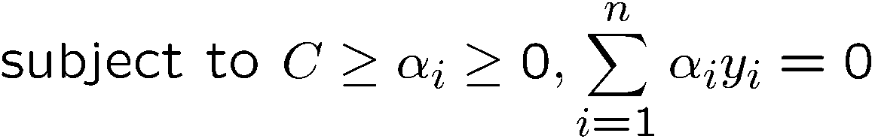
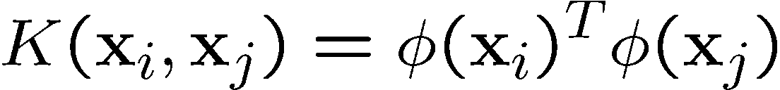
The Kernel Trick
Recalling the SVM optimization problem
The data points only appear as inner product
Many common geometric operations (angles, distances) can be expressed by inner products.
Define the kernel function K by

Slide 26
An Example for φ(.) and K(.,.)
Suppose φ(.) is given as follows
An inner product in the feature space is
So, if we define the kernel function as follows, there is no need to carry out φ(.) explicitly
This use of kernel function to avoid carrying out φ(.) explicitly is known as the kernel trick

Slide 27
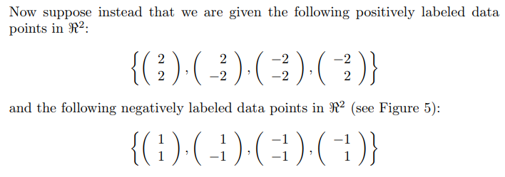
SVM – Linearly Inseparable data - Example
Notes:
Take abs(x1) and abs(x2)

Slide 28
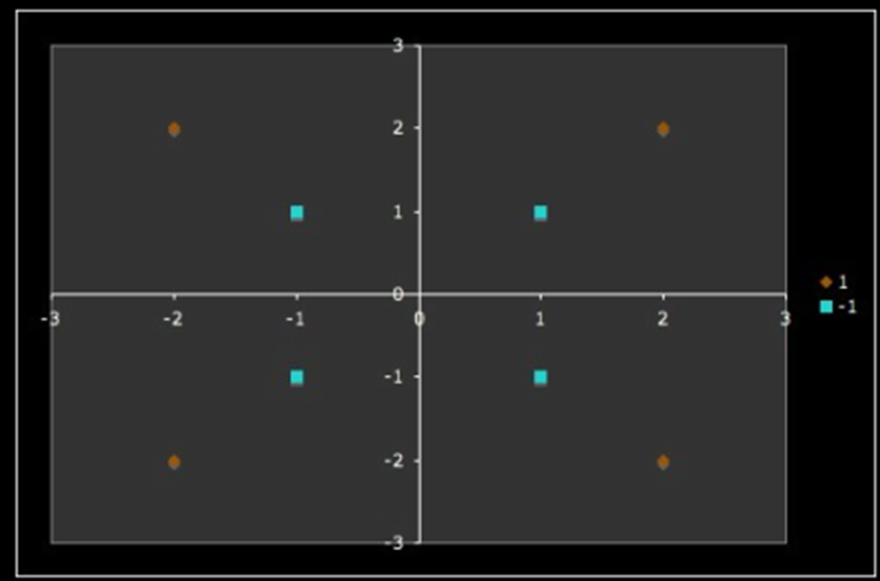
Nonlinearly separable sample data points - Example

Slide 29
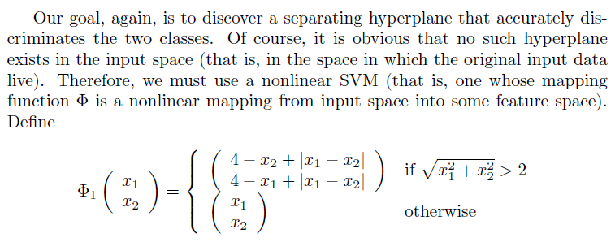
Non-Linear SVM – Example (cont’d)
Notes:
Take abs(x1) and abs(x2)

Slide 30
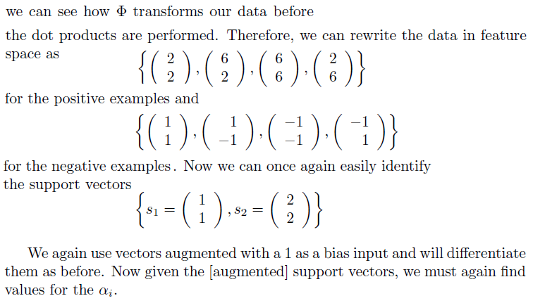
Example (cont’d)

Slide 31
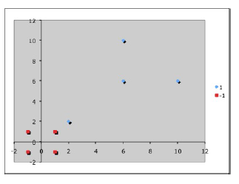
Data represented in feature space -Example (cont’d)

Slide 32
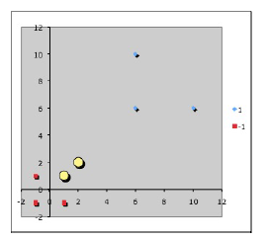
Data represented in feature space - Example (cont’d)
The two support vectors (in feature space) are marked as yellow circles.

Slide 33
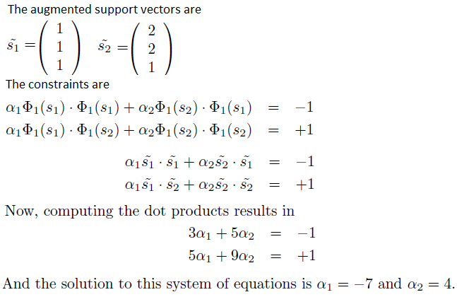
Example (cont’d)

Slide 34
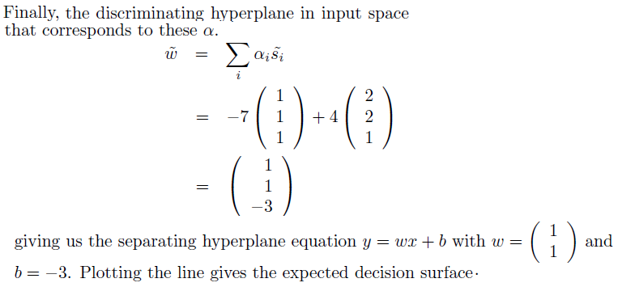
Example (cont’d)

Slide 35
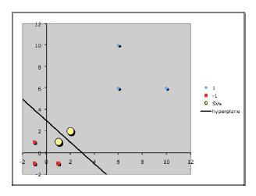
Hyperplane - Example (cont’d)
The discriminating hyperplane corresponding to the values α₁ = -7 and α₂ = 4

Slide 36
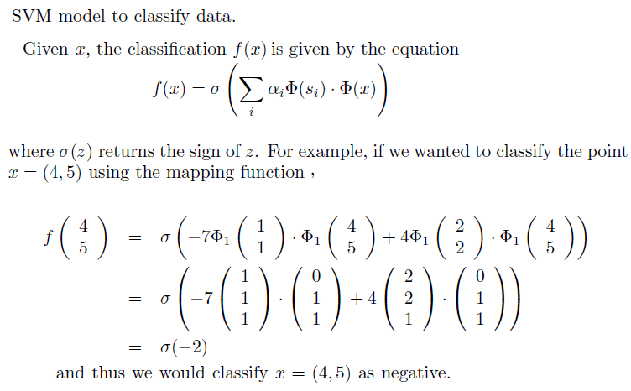
SVM in classification

Slide 37
Not linearly separable - Soft Margin Hyperplane
Not linearly separable
Soft error
New primal is

Slide 38
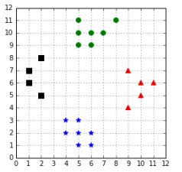
Multi-Class SVM
SVMs are able to generate binary classifiers. However, we are often faced with datasets having more than two classes.
Convert them into binary classification problems and solve one by one or one against all

Slide 39
Multi-Class SVM
One against all or one against rest
In order to classify K classes,
construct K different binary classifiers.
For a given class,
the positive examples are all the points in the class, and
the negative examples are all the points not in the class
Training
train one binary classifier on each problem thereby one decision boundary per classifier is obtained
Testing
use each classifier and predict the class of the classifier if it returns a positive answer
Drawback 1- inconsistent results because a label is assigned to multiple classes simultaneously or to none
Drawback2- that training sets are imbalanced. For a problem with 100 classes, each having 10 examples, each classifier will be trained with 10 positive examples and 990 negative examples
Solution - Vladimir Vapnik suggested using the class of the classifier for which the value of the decision function is the maximum

Slide 40
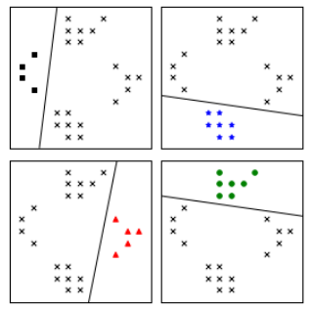
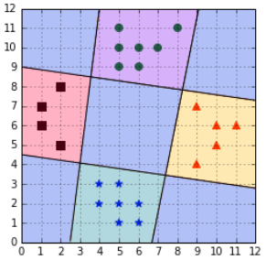
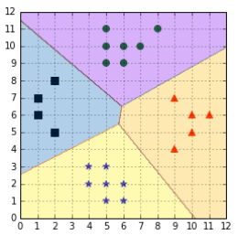
One against all or one against rest

Slide 41
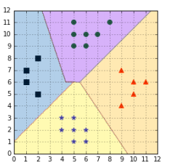
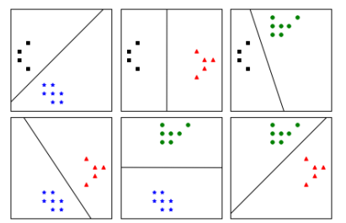
Multi-Class SVM
One-against-one
Distinguish one class from another one.
Train one classifier per pair of classes, which leads to K(K-1)/2 classifiers for K classes.
Each classifier is trained on a subset of the data and produces its own decision boundary
Predictions are made using a simple voting strategy

Slide 42
Soft Margin Hyperplane
Not linearly separable
Soft error
New primal is

Slide 43
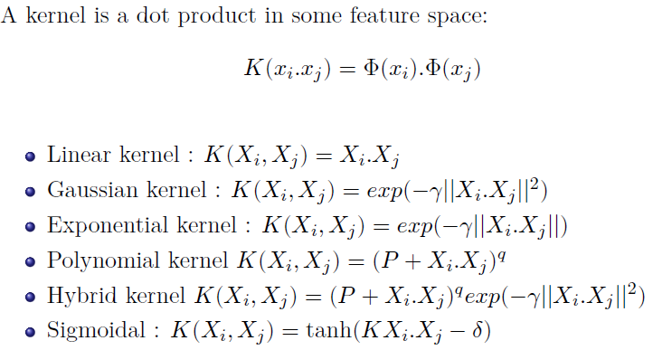
Examples of Kernel Functions

